Slide 1

DDoS Protection System for Cloud
Protecting cloud-based applications from Distributed Denial of Service (DDoS) attacks is crucial for ensuring reliable and uninterrupted service. This comprehensive guide outlines the key components of a robust DDoS protection system designed for the cloud environment.
RP

Slide 2

Understanding DDoS Attacks
1
Volumetric Attacks
Aim to consume the bandwidth of the target, such as UDP floods, ICMP floods, and DNS amplification attacks.
2
Protocol Attacks
Exploit vulnerabilities in protocols like TCP, HTTP, or SSL, including SYN floods, ping of death, and fragmented packet attacks.
3
Application Layer Attacks
Target specific web applications by exhausting resources like CPU or memory, such as HTTP GET/POST floods, slowloris attacks, and DNS query floods.

Slide 3
Architecting the DDoS Protection System
Detection Layer
Mitigation Layer
Response and Scaling Layer
Responsible for identifying potential DDoS attacks before they can cause significant harm, using traffic monitoring, analytics, and machine learning-based detection.
Filters out malicious traffic while allowing legitimate traffic through, using web application firewalls (WAF) and traffic filtering/scrubbing techniques.
Ensures the system can handle the attack by automatically scaling resources and distributing traffic using auto-scaling, CDNs, and load balancing.

Slide 4
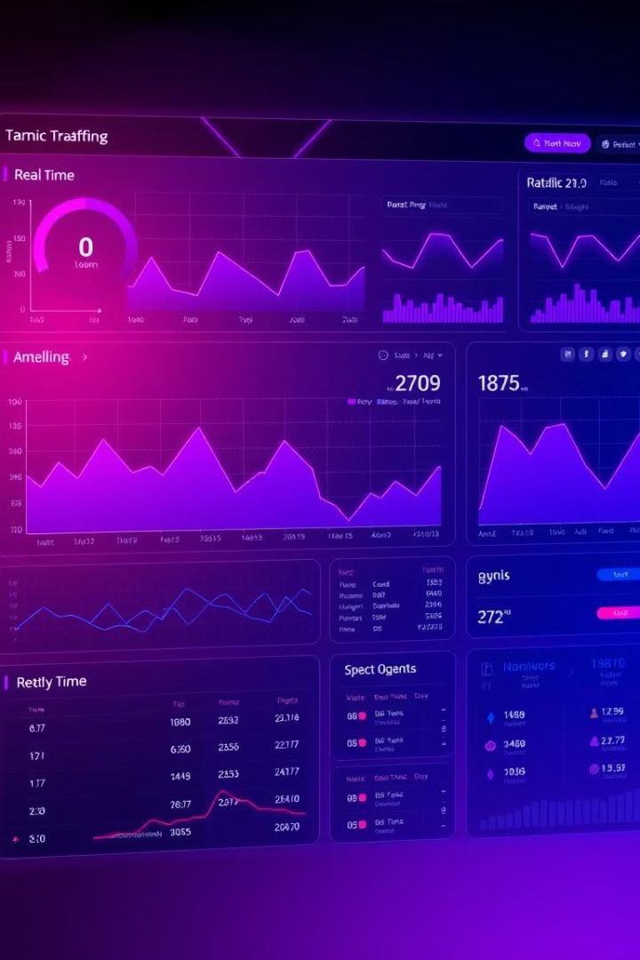
Detection Layer: Monitoring and Analytics
1
Traffic Monitoring
Use our program/ ML to monitor network traffic and identify patterns that may indicate an ongoing or potential attack.
2
Machine Learning-Based Detection
Leverage machine learning models to detect anomalies and patterns in traffic that could signify an attack, Scikit-learn.
3
Real-Time Analysis
Continuously monitor traffic and apply the trained models to detect unusual patterns, enabling early detection and response to DDoS threats.

Slide 5



Mitigation Layer: WAF and Traffic Filtering
Web Application Firewall (WAF)
Traffic Filtering and Scrubbing
Protect web applications by filtering and monitoring HTTP requests, using techniques like rate limiting, IP blacklisting/whitelisting, and custom rules.
Separate malicious traffic from legitimate traffic using scrubbing centers and geofencing, with tools like our ML/program.

Slide 6



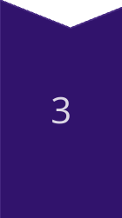
Response and Scaling Layer
Auto-Scaling
Automatically increase resources to handle increased traffic during an attack, using cloud-native auto-scaling features .
CDN and Anycast Routing
Distribute traffic across multiple locations to prevent any single server from being overwhelmed, leveraging CDN caching and Anycast routing.
Load Balancing
Distribute incoming network traffic across multiple servers to ensure no single server becomes a bottleneck, using techniques like round-robin, least connections, and IP hashing.

Slide 7

Security Best Practices
Regular Updates
Continuously update WAF rules, ML models, and filtering policies based on the latest threat intelligence.
Multi-Layered Security
Use a combination of network, application, and infrastructure-level protections for a robust defense.
Redundancy and Failover
Implement redundancy and failover mechanisms to maintain service availability during attacks.
Periodic Testing
Regularly test the system with simulated attacks to ensure effectiveness and identify weaknesses.

Slide 8

Implementation Process
Set Up Monitoring and Analytics
Deploy Prometheus, Grafana, and Elastic Stack (ELK) for real-time traffic monitoring and log aggregation, and collect data for training machine learning models.
Implement ML-Based Detection
Train models using historical traffic data and implement real-time monitoring with TensorFlow or Scikit-learn to flag anomalies and trigger alerts.
Configure WAF and Filtering
Set up a web application firewall with pre-configured rules and custom policies, and deploy traffic scrubbing centers to mitigate known threats.
Implement Auto-Scaling and Load Balancing
Configure auto-scaling policies and load balancers to automatically adjust resources and distribute traffic during an attack, integrating with a CDN.

Slide 9

This layer will store all the databases which are collected from each layer.
This layer also stores the username and password of host and client , client’s storage , current users , logged-in users, blacklisted and whitelisted IP’s , and the network traffic’s continuous graphs.
This layer is primarily used for storing the pattern of the previous attacks which will be compared to the current/on-going attack and the current attack gets detected and stopped in short period of time.
Why choosing MongoDB?
MongoDB offers flexible schema, scalability, and faster performance for unstructured data compared to MySQL.

Slide 10
Thank you , we need your view of advice and an basic
Suggestion, to make our vision into creation, Once again
Thank you.

